Slide 1
Lecture 22
Ethical Hacking

Slide 2
Objectives
Ethical hacking
What you can do legally as an ethical hacker
What you cannot do as an ethical hacker

Slide 3
Hacker and Ethical hacker
Hackers
  Access computer system or network without authorization
  Breaks the law; can go to prison
Ethical hacker
  Performs most of the same activities but with owner’s permission
  Employed by companies to perform penetration tests

Slide 4
Penetration test vs. Security test
Penetration test
  Legal attempt to break into a company’s network to find its weakest link
  Tester only reports findings
Security test
  More than an attempt to break in; also includes analyzing company’s security policy and procedures
  Tester offers solutions to secure or protect the network

Slide 5
Penetration test & Security test
Programming languages used by experienced penetration testers
  Practical Extraction and Report Language (Perl)
  C
Tiger box
  Collection of OSs and hacking tools
  Helps penetration testers and security testers conduct vulnerabilities assessments and attacks

Slide 6
Penetration-Testing Methodologies
Penetration-Testing Methodologies
  White box model
  Black box model
  Gray box model
White box model
  Tester is told everything about the network topology and technology
  Tester is authorized to interview IT personnel and company employees
  Makes tester job a little easier

Slide 7
Penetration-Testing Methodologies (continued)
Black box model
  Company staff does not know about the test
  Tester is not given details about the network
    Burden is on the tester to find these details
  Tests if security personnel are able to detect an attack
Gray box model
  Hybrid of the white and black box models
  Company gives tester partial information

Slide 8
Certification Programs for Network Security Personnel
Penetration testers need to have
  the technical skills
  good understanding of networks
  the role of management in an organization.
Network security certification programs
  Certified Ethical Hacker (CEH)
  OSSTMM Professional Security Tester (OPST)
  Certified Information Systems Security Professional (CISSP)
  Global Information Assurance Certification (GIAC)
Certifications that help prepare for these certifications
  CompTIA Security+
  Network+

Slide 9
Certified Ethical Hacker (CEH)
Developed by the International Council of Electronic Commerce Consultants (EC-Council)
  Based on 21 domains (subject areas)
  Web site: www.eccouncil.org
  Red team: Composed of people with varied skills
    Conducts penetration tests

Slide 10
OSSTMM Professional Security Tester (OPST)
Designated by the Institute for Security and Open Methodologies (ISECOM)
  Based on the Open Source Security Testing Methodology Manual (OSSTMM)
  Consists of 5 domains
  Web site: www.isecom.org
Notes:
The methodology itself that covers what, when, and where to test is free to use and distribute under the Open Methodology License (OML).
This manual is about operational security (OPSEC). It is about measuring how well security works.

Slide 11
Certified Information Systems Security Professional (CISSP)
Issued by the International Information Systems Security Certifications Consortium (ISC²)
  Usually more concerned with policies and procedures
  Consists of 10 domains
  Web site: www.isc2.org
Notes:
global, not-for-profit leader in educating and certifying information security professionals throughout their careers.
global, not-for-profit leader in educating and certifying information security professionals throughout their careers.
60,000 certified members

Slide 12
SANS Institute
SysAdmin, Audit, Network, Security (SANS)
  Offers certifications through Global Information Assurance Certification (GIAC)
  Top 20 list
    One of the most popular SANS Institute documents
    Details the most common network exploits
    Suggests ways of correcting vulnerabilities
  Web site: www.sans.org
Notes:
provides a set of computer security certifications linked to the training courses provided by the SANS. GIAC is specific to the leading edge technological advancement of IT security
the SANS organization changed the format of the certification by breaking it into two separate levels. The "silver" level certification requires two multiple-choice tests, whereas the "gold" level certification has both the multiple-choice tests requirement as well as a practical.

Slide 13
Objectives
Ethical hacking
What you can do legally as an ethical hacker
What you cannot do as an ethical hacker

Slide 14
What You Can Do Legally
As an ethical hacker, be aware of what is allowed and what is not allowed
  Laws involving technology change as rapidly as technology itself
  Find what is legal for you locally
    Laws change from place to place
Some hacking Tools on your computer might be illegal to possess
  Contact local law enforcement agencies before installing hacking tools
Notes:
In UK and Germany, using or writing real hacking tools like Nessus, Metasploit, Hydra, Amap, John, other exploits are fairly telltale illegal
Some people against this idea claim that “If you own a crow bar, a favored tool for breaking through locked doors, that’s fine. If you own a baseball bat, a wonderful tool which many put to use bashing in people’s skulls, that’s fine. Own a piece of software that can port scan, and you break the law.”

Slide 15
Is Port Scanning Legal?
Federal Government does not see it as a violation
  Allows each state to address it separately
  Some states deem it legal
    As noninvasive or nondestructive in nature
    Not always the case
Read your ISP’s “Acceptable Use Policy”

Slide 16
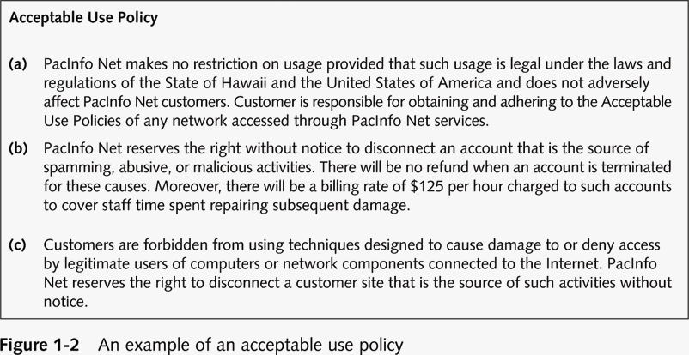

Slide 17
Federal Laws
Federal computer crime laws are getting more specific
  Cover cybercrimes and intellectual property issues
Computer Hacking and Intellectual Property (CHIP)
  New government branch to address cybercrimes and intellectual property issues

Slide 18
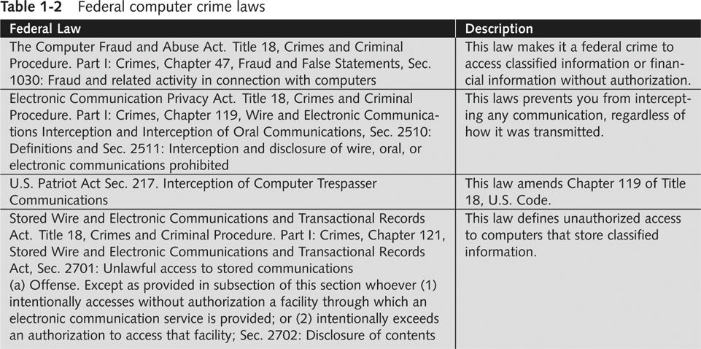

Slide 19
Objectives
Ethical hacking
What you can do legally as an ethical hacker
What you cannot do as an ethical hacker

Slide 20
What You Cannot Do Legally
Accessing a computer without permission is illegal
Other illegal actions
  Installing worms or viruses
  Denial of Service attacks
  Denying users access to network resources
As an independent contractor (ethical hacker), using a contract is just good business
  Contracts may be useful in court
  Internet can also be a useful resource
  Have an attorney read over your contract before sending or signing it

Slide 21
Ethical Hacking in a Nutshell
What it takes to be a security tester ?
  Knowledge of network and computer technology
  Ability to communicate with management and IT personnel
  Understanding of the laws
  Ability to use necessary tools

